Slide 1


LetterBuddy
A Handwriting Exercise Application for Children with an OCR Based Feedback
Presenters: Erez Lavi Ofir Beck

Slide 2
The Problem
Alarming decrease of personal guidance in the
handwriting learning process
Decreased time in class dedicated for exercising handwriting skills
Increased amount of teachers that don’t consider themselves trained to teach handwriting
Growing amount of students in each class
(based on our literature review)
Increased difficulty for the teachers to
give individualized instructions and
provide appropriate guidance
for each child in their class

Slide 3
The Solution
LetterBuddy
Aiming to provide the children with the personalized handwriting exercise experience that they should’ve experience in class, including:
Personalized random generated exercises based on past performance, allowing for non-stop exercising.
Feedback based on their submitted exercises (which are written on a blank paper and captured by their device camera).
While allowing for the adults who guide them to keep track of their progression.

Slide 4
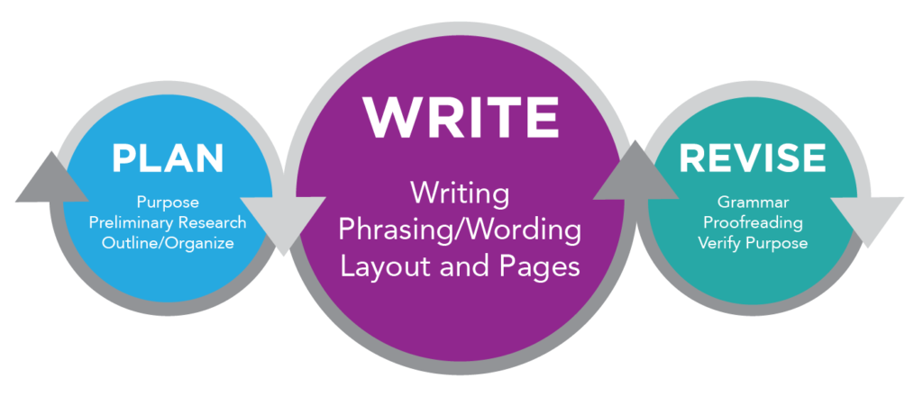
Literature Review: Main Findings
Identified Struggles
According to studies, children who struggle with the writing process often struggle with the Planning step.
Ways to Improve Handwriting
Positive Feedback
Practice
Explicit instructions
Motivation
Feedback
Feedback which focuses on what the child wrote right has been shown to be the most effective.

Slide 5

Literature Review: Main Findings
AI as a Learning Guider
An AI solution that will automate, personalize and evaluate the handwriting exercise process could be a major aid during it.
OCR Engines Comparative Analysis
Simplified Design
The interface should be easy to navigate with clear buttons, simple visuals, and age appropriate language.
Paddle OCR model achieved the highest accuracy score among the popular open source models on handwritten text. (tesseract, Keras CNN)

Slide 6
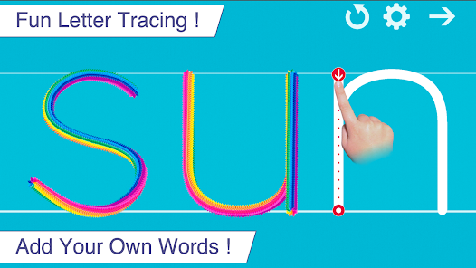
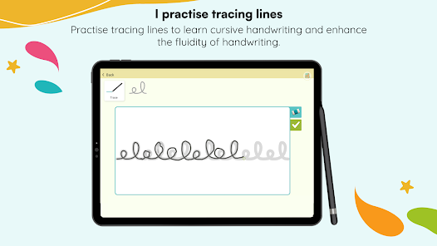
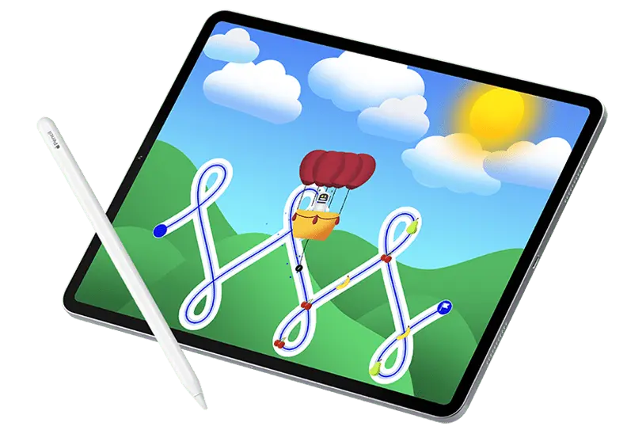
Competitor Analysis: Existing Handwriting Apps
App
Requirements
Progression tracking
Handwriting Feedback
Writing Wizard
Android/IOS
Non
Real time feedback on the child’s tracing
Kaligo
Ipad + Stylus
Includes replayable videos of the child’s handwriting and the score given.
Real time feedback on stylus tracing and AI feedback per character.
Dynamilis
Ipad + Stylus
(ios only)
Includes graphs of the child’s handwriting performance per week.
Real time color based basic feedback system- according to writing quality.

Slide 7
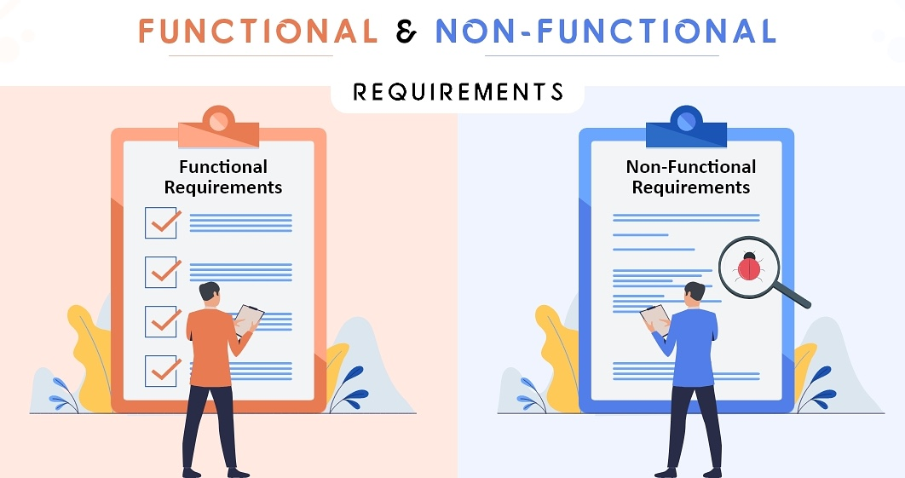




Functional Requirements
Handwriting Guidance
Handwriting Exercises
Offer content about correct handwriting for both the children and the adults.
Offer the child exercises based on his past performance.
AI Feedback
Progression Tracking
Based on the OCR’s evaluation, provide a mostly positive feedback to the child.
Adult that guide the child will be able to view their metrics and performance.

Slide 8



Non-Functional Requirements
Portability
Accessibility
A fitting design for both PC and mobile users.
Support all popular browsers.
Clear UI with big buttons and minimum text - fit for children ages 5-12
Performance
The content the child will be requested to write will be generated in 3 seconds or less at least 95% of the time
The handwritten capture submitted by the child will be analyzed in 5 seconds or less at least 90% of the time

Slide 9
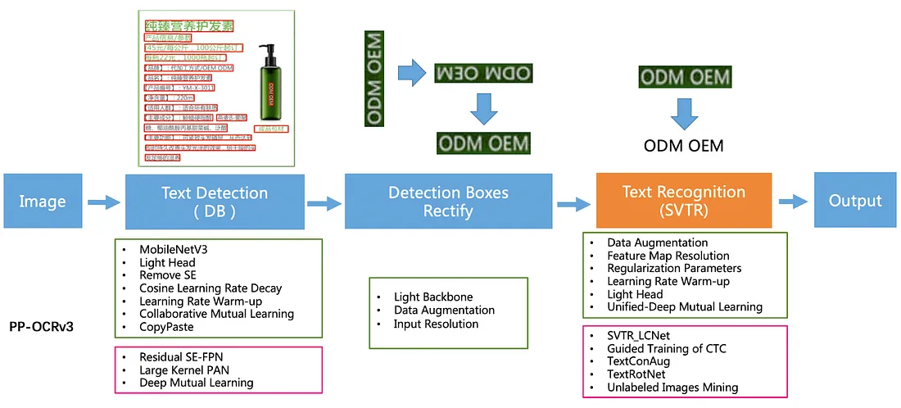
Algorithms: PaddleOCR Handwriting Recognition

Slide 10




Algorithms: Adaptive Exercises Generation
Difficulty Levels
Category Planning Step Exercises
Exercises where a broad category is given, and the child will write a
Word he thought about from that category (like “Name an Animal” etc..)
3
Generates
Generates
Words of a Certain Category
2
Exercises to write a specific word that is shown to the
WordNet
Letters
1
Exercises on writing a letter from the writer’s alphabet, one or more times.

Slide 11
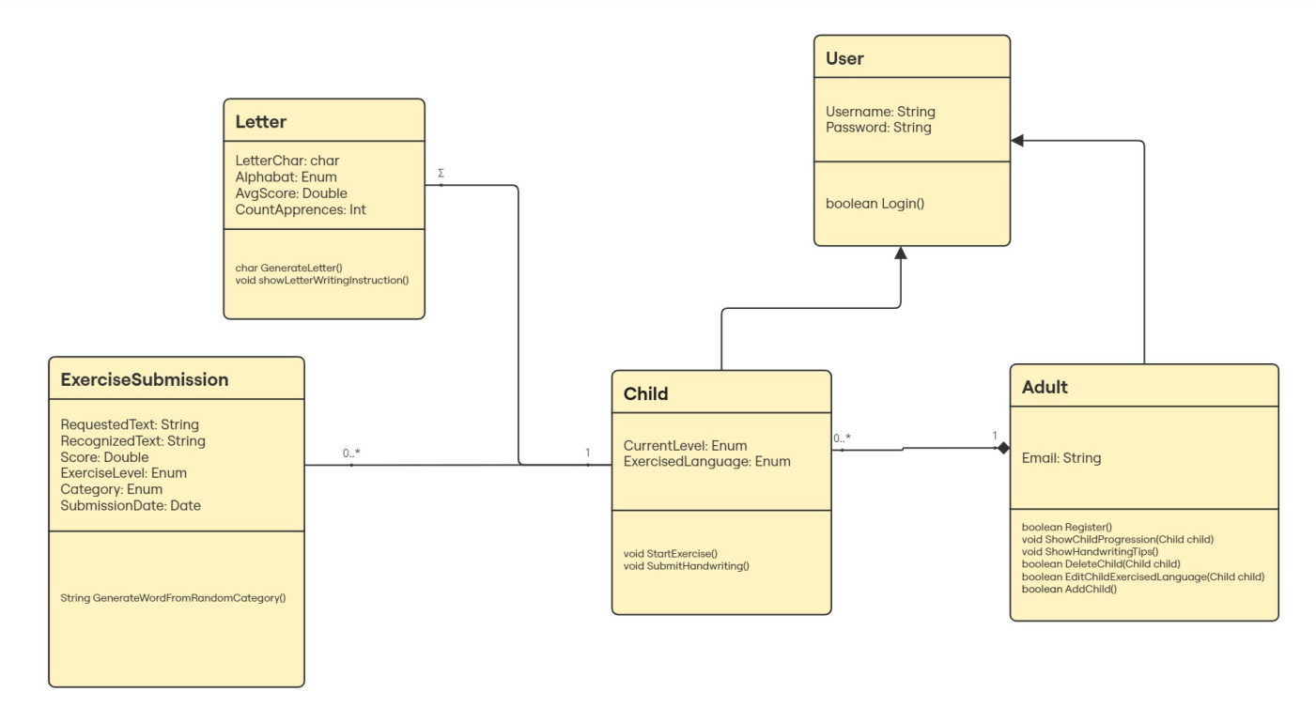

Database Structure

Slide 12
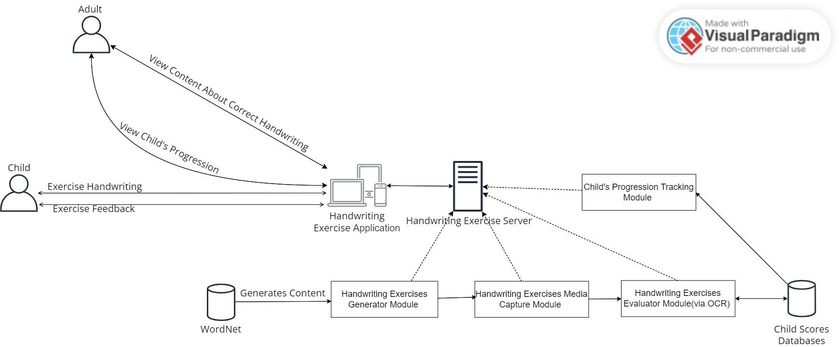

Architecture Diagram

Slide 13
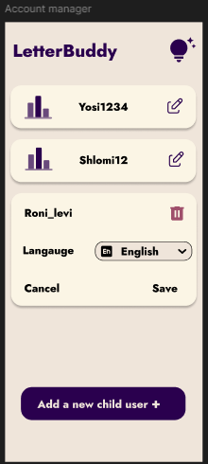
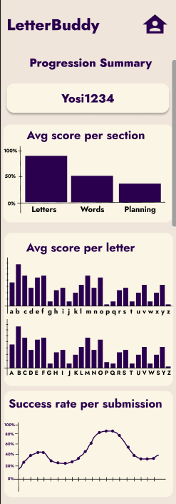
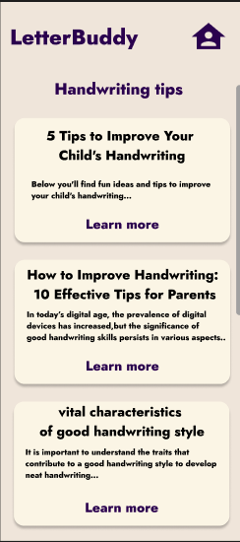
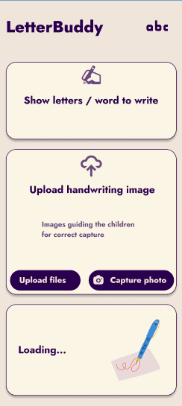


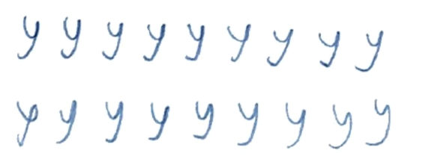

UI Design: Mobile
Adult
Child

Slide 14
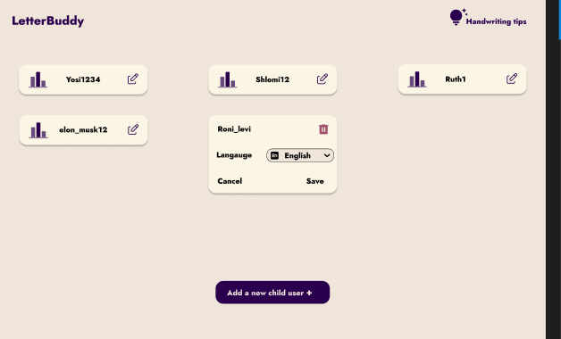
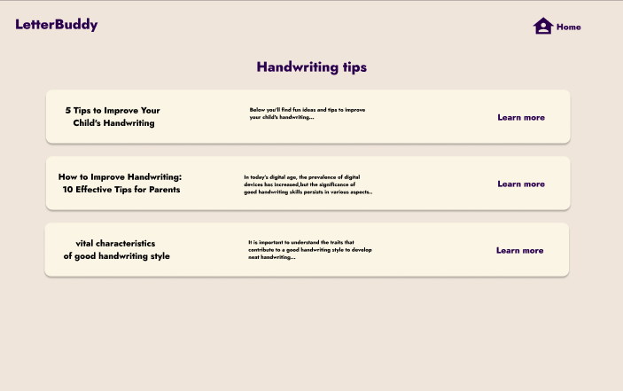
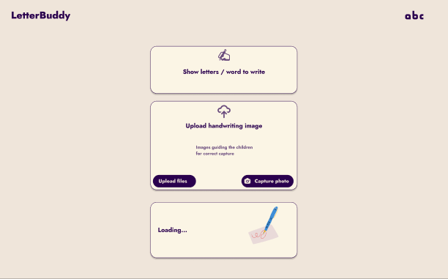
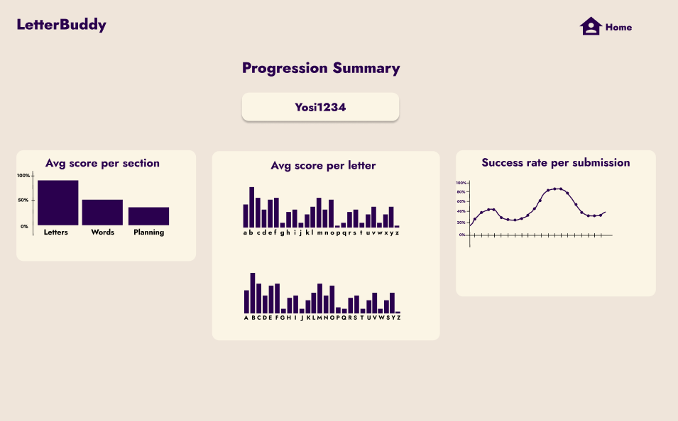
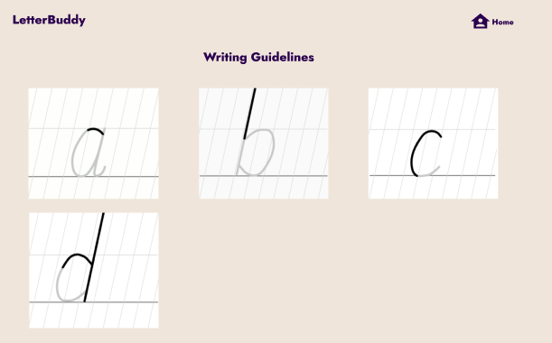
UI Design: Desktop
Adult
Child

Slide 15


Development Stages
1
2
3
4
5
6
Setting Requirements and Planning
System Design
Coding
Testing
Deployment
Maintenances and Support
Handwriting Exercises Evaluator: 1. Choose and fine-tune a fitting ML model for handwritten text. 2. Modify it in order to get confidence score per letter
Handwriting Exercises Generator using WordNet
Handwriting Exercises
Media Capturer
Child’s Progression
Tracking
Backend which communicates with these modules & Frontend

Slide 16

Thank You For Listening!

